Slide 1
Chapter 6:
The digestive system supplies nutrients for the body

Slide 2
6.1 Types of digestion
Digestion is the process of breaking down of carbohydrate, protein and fat molecules into products small enough to be absorbed into the blood and into the cells.
Mechanical digestion
Mechanical digestion is the physical breakdown of food particles into smaller pieces to increase the surface area.
The teeth cut, tear and grind the food.
Churning action in the stomach breaks the food down further.
The gall bladder releases bile into the small intestine. Bile salts act as emulsifying agents, breaking fat down into smaller droplets.
The increased surface area allows more effective chemical digestion, as the chemicals can access more of the food.

Slide 3
6.1 Types of digestion
Chemical digestion
Chemical digestion uses enzymes to break down large, complex molecules into smaller, simpler molecules. These smaller molecules are then small enough to be absorbed into the bloodstream.
Carbohydrates split into monosaccharides such as glucose, fructose and galactose.
Proteins are split into peptides and amino acids.
Lipids are split into fatty acids and glycerol.
Nucleic acids are split into nucleotides.

Slide 4
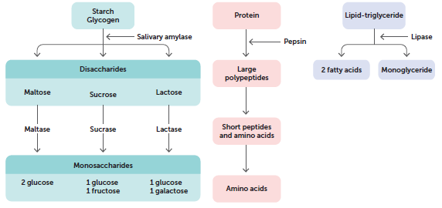
6.1 Types of digestion

Slide 5
6.2 The alimentary canal
The alimentary canal is the continuous tube that runs from the mouth to the anus. Together with associated organs such as the pancreas and the gall bladder, the alimentary canal makes up the digestive system.
The lining of the alimentary canal is the surface through which nutrients are absorbed.

Slide 6
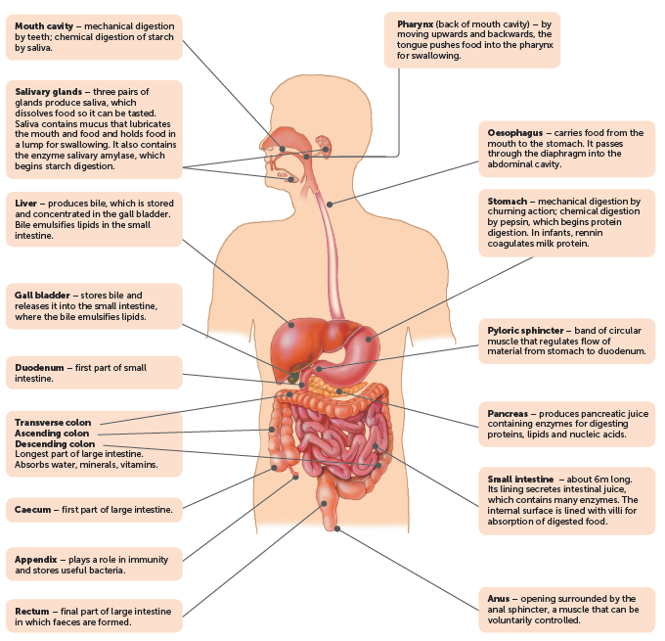
6.2 The alimentary canal

Slide 7
6.2 The alimentary canal
Mouth
Intake of food, called ingestion, occurs at the mouth. Food is chewed in a process called mastication.
As the food is chewed it is mixed with saliva, which contains mucus to lubricate the food and a digestive enzyme – salivary amylase – which begins the chemical digestion of starch into the disaccharide maltose.
The action of the jaws and teeth (incisors, canines, premolars and molars) begins mechanical digestion.
After chewing, the tongue shapes the food into a rounded lump called a bolus. To swallow, the tongue moves upwards and backwards, pushing the bolus into the back of the mouth, the pharynx, which leads to the oesophagus.

Slide 8
6.2 The alimentary canal
Oesophagus
The oesophagus is a tube about 23–25 cm long that connects the pharynx to the stomach. The wall of the oesophagus, like the rest of the alimentary canal, has a double layer of muscle. Circular muscle has muscle fibres arranged in a circle, and longitudinal muscle has fibres arranged along the length of the canal.
As the lump of food enters the pharynx and oesophagus, the circular muscle behind it contracts to narrow the tube. The contraction of successive bands of circular muscle causes the constriction to move in a wave called peristalsis. This movement pushes the food in front of it, assisted by the secretion of mucus that lubricates the inner lining.

Slide 9
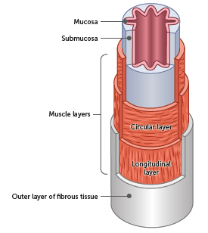
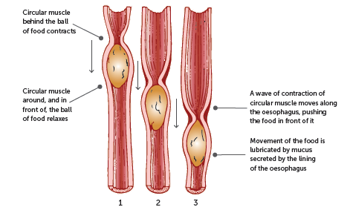
6.2 The alimentary canal
Structure of the oesophagus
Process of peristalsis

Slide 10
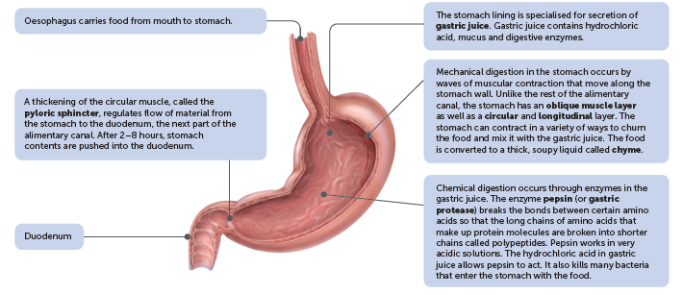
6.2 The alimentary canal
Stomach
The oesophagus opens into the stomach, an enlarged section of the alimentary canal. Food undergoes mechanical and chemical digestion in the stomach.
Nutrients are not absorbed into the bloodstream through the stomach because the internal surface is covered by a thick layer of mucus.

Slide 11
6.2 The alimentary canal
Small intestine
The small intestine is the longest part of the alimentary canal, at approximately 6–7 m in length. It receives material pushed through the pyloric sphincter from the stomach. It has three regions:
Duodenum: first part, extends from the bottom end of the stomach in a curve around the pancreas. Most of the chemical digestion occurs here before the chyme moves further along the small intestine.
Jejunum: middle section, its lining allows effective absorption of carbohydrates and proteins.
Ileum: final part, where B12, bile salts, and any remaining products of digestion are absorbed.
Digestion continues in the small intestine under the influence of pancreatic juice, bile and intestinal juice.
Mechanical digestion also continues in the small intestine through a process called segmentation.

Slide 12
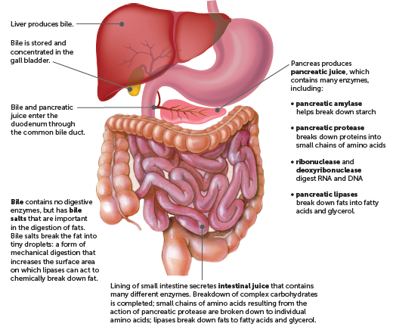
6.2 The alimentary canal

Slide 13
6.2 The alimentary canal
Absorption of nutrients
The products of digestion, along with substances such as vitamins, minerals and water, are absorbed through the wall of the small intestine into the blood.
The lining of the small intestine has folds, villi and microvilli, to maximise the absorption of nutrients.

Slide 14
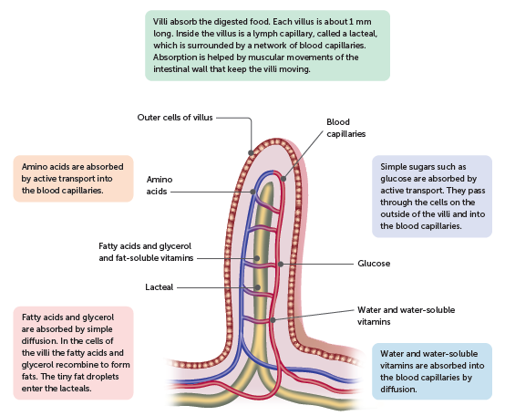
6.2 The alimentary canal
Absorption of nutrients into blood and lymph

Slide 15
6.2 The alimentary canal
Large intestine
The large intestine is about 1.5 m long and is made up of the caecum, colon, rectum and anus. Additionally, the appendix attaches to the caecum.
There are no villi in the large intestine, and no digestive juices are secreted, although the lining does secrete a large amount of mucus. Movement of material through the large intestine is fairly slow, taking 18–24 hours for material to pass through. During this time, most of the remaining water is absorbed so the contents become more solid.
Bacteria in the large intestine break down much of the remaining organic compounds. Some bacteria produce vitamins, which are then absorbed through the walls into the blood. Mineral nutrients are also absorbed.
The semi-solid material left after water absorption and bacterial action makes up the faeces.

Slide 16
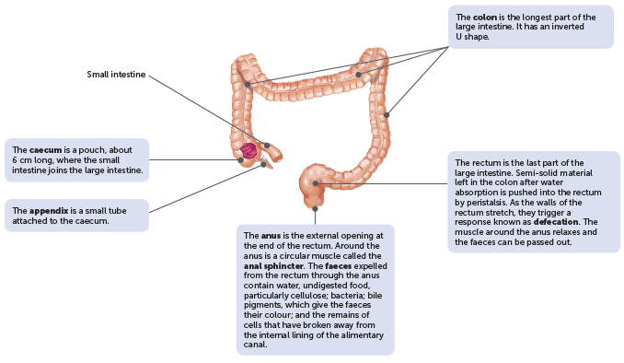
6.2 The alimentary canal

Slide 17
6.3 The effect of diet on the alimentary canal
A healthy diet is important for a healthy digestive system.
Constipation
Constipation occurs if the movements of the large intestine are reduced and the contents remain there for a long period of time. As water is absorbed, the faeces become drier and harder than usual. Defecation becomes difficult and possibly painful. It may be caused by a lack of roughage (cellulose, or insoluble fibre) in the diet.
Diarrhoea
Diarrhoea is characterised by frequent defecation of watery faeces. It is caused by irritation of the small or large intestine, which increases peristalsis so that the contents of the intestines move through before there is adequate absorption of water. Such irritation may be the result of a bacteria, virus, parasite, cancer, coeliac disease or lactose intolerance.

Slide 18
6.3 The effect of diet on the alimentary canal
Bowel cancer
Bowel cancer, or colorectal cancer, is an uncontrolled growth of cells in the wall of the large intestine. Research suggests that bowel cancer may be linked to diet, high alcohol consumption and smoking. A diet high in red and processed meat, and low in fibre (fruit and vegetables), may increase the risk of developing bowel cancer.
Coeliac disease
People with coeliac disease are unable to tolerate gluten, which is found in wheat, rye and barley. If they eat food containing gluten, their immune system responds by damaging or destroying the villi in the small intestine. Without healthy villi, nutrients cannot be absorbed, and the person becomes malnourished no matter how much food they eat.

